Slide 1
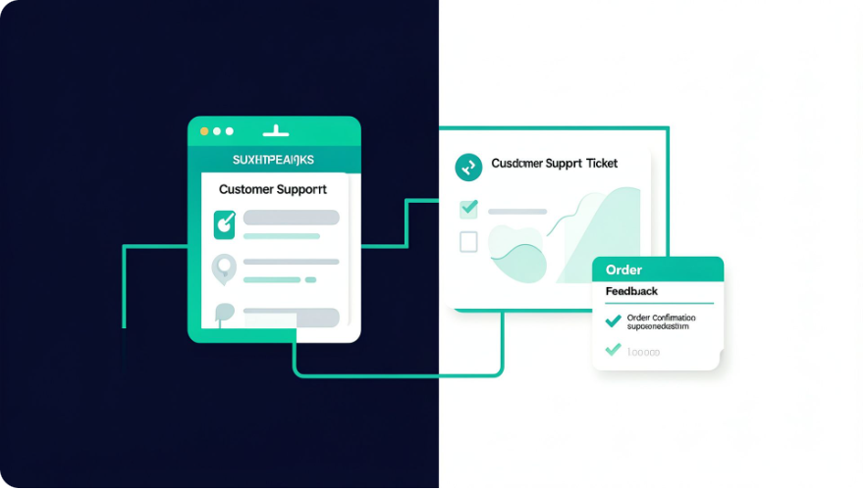
01 / PORTFOLIO PROJECT
THE BUSINESS QUESTION
Where does support data become a better decision?
01
02
Customer
Order
AI-Powered
Customer Support
& Product Intelligence
Understand risk, experience, and recurring issues.
Read delivery, cancellation, and revenue signals.
03
04
Feedback
Action
An end-to-end Business Analytics portfolio project showing how customer, order, and feedback data can become actionable recommendations.
Connect themes and sentiment to business context.
Turn analysis into focused recommendations.
01 / 05 · Customer Support & Product Intelligence | Business Analytics Project

Slide 2
02 / METHOD
From Raw Data to Business Insights
Dataset
Analysis workflow
300 customer records
1,118 orders imported into MySQL
318 feedback records
Excel — profiling, cleaning, formulas, PivotTables, and inactivity-based churn classification
MySQL — filtering, aggregation, joins, CASE statements, and date functions across orders, cancellations, revenue, and feedback
Power BI — KPI cards, slicers, monthly trends, category revenue, customer status, feedback themes, and sentiment
Data-quality note: the source workbook was expected to contain 1,119 orders, but 1,118 were imported into MySQL; the discrepancy remains unresolved.
02 / 05 · Customer Support & Product Intelligence | Business Analytics Project

Slide 3
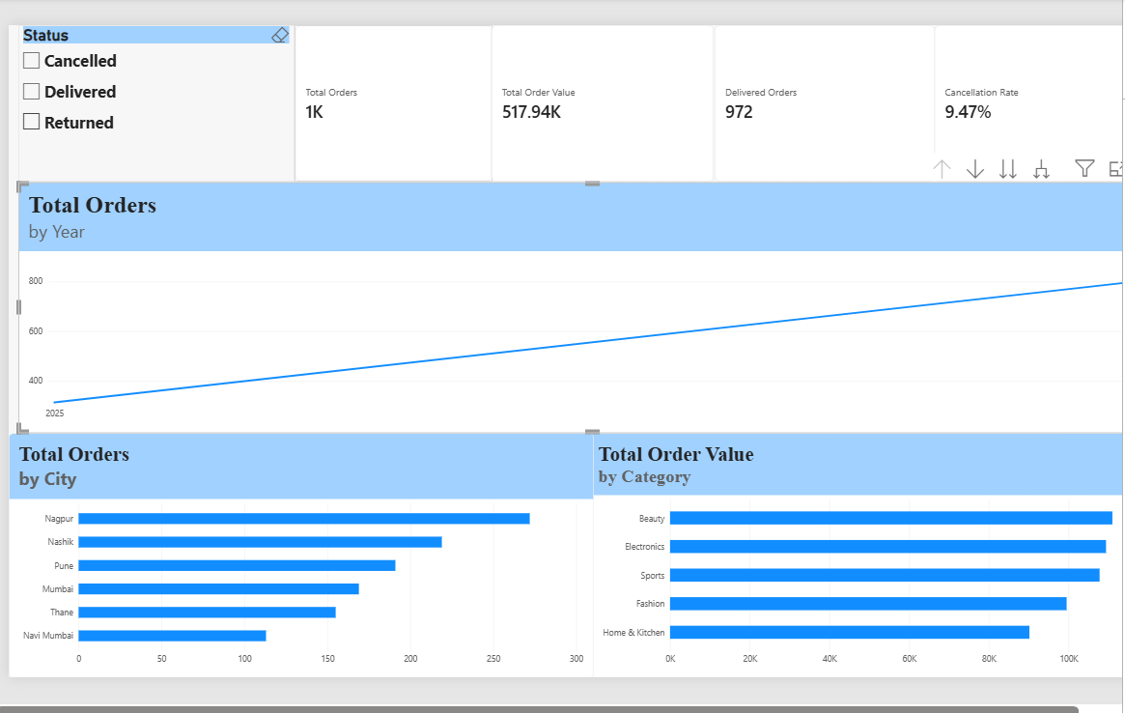
03 / BUSINESS OVERVIEW
ORDER PERFORMANCE & BUSINESS OVERVIEW
Verified operational signals, with open fields marked for completion.
03 / 05 · Customer Support & Product Intelligence | Business Analytics Project

Slide 4
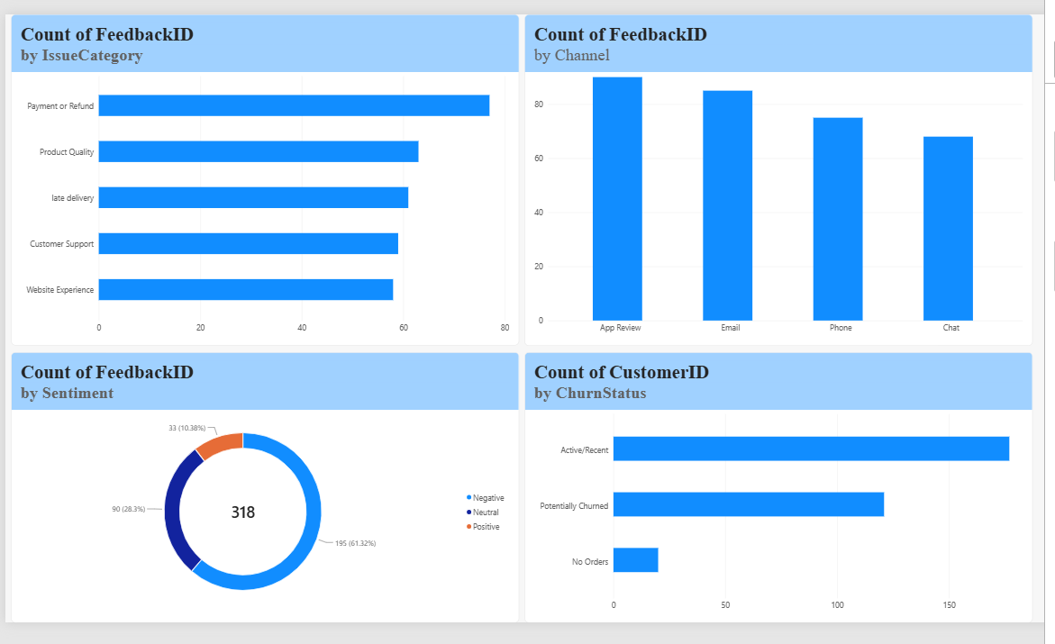
04 / CUSTOMER INTELLIGENCE
Understanding Customer Risk & Customer Experience
Risk signals are prompts for investigation, not final diagnoses.
CUSTOMER & FEEDBACK SIGNALS
View | Signals / data to insert
Customer status | Potentially churned (90-day inactivity rule): 112; No recorded orders: 19; Other statuses: Data to insert
Feedback issue | Payment or Refund: 77; Other issue categories: Data to insert
Sentiment | Negative: 194; lowercase negative: 1
Feedback channel | Channel: Data to insert; Records: Data to insert
Standardization is required before publishing final metrics.
04 / 05 · Customer Support & Product Intelligence | Business Analytics Project

Slide 5
05 / RECOMMENDATIONS
Turning Analysis into Action
Conclusion: Excel, MySQL, and Power BI can transform customer, order, and feedback data into actionable business recommendations.
Payment & Refund Resolution
Cancellation Reduction
Investigate payment failures, refund delays, and recurring complaints; track resolution time and repeat complaints.
Analyze cancellation reasons by city, category, and month; prioritize verified drivers rather than assuming a city causes cancellations.
Customer Re-engagement
Data Quality Improvement
Test a targeted campaign for potentially churned customers and measure reactivation and repeat purchases against an appropriate comparison group.
Standardize city names, issue categories, and sentiment labels; reconcile the missing order record before publishing final metrics.
LIMITATIONS
Synthetic dataset; inactivity-based churn proxy; recommendations not experimentally tested; financial impact not measured; order-count discrepancy unresolved.
Thank You | Questions?
05 / 05 · Customer Support & Product Intelligence | Business Analytics Project

